Slide 1
Matplotlib
Noble Xavier

Slide 2
MATPLOTLIB

Slide 3
Matplotlib
Matplotlib is a popular plotting library in Python that is used to create high-quality visualisations and graphs.
It offers various tools to generate diverse plots, facilitating data analysis, exploration, and presentation
Matplotlib is a powerful plotting library in Python used for creating static, animated, and interactive visualizations.

Slide 4
Features of Matplotlib
Key Features of Matplotlib:
Versatility: Matplotlib can generate a wide range of plots, including line plots, scatter plots, bar plots, histograms, pie charts, and more.
Customization: It offers extensive customization options to control every aspect of the plot, such as line styles, colors, markers, labels, and annotations.
Integration with NumPy: Matplotlib integrates seamlessly with NumPy, making it easy to plot data arrays directly.
Publication Quality: Matplotlib produces high-quality plots suitable for publication with fine-grained control over the plot aesthetics.
Extensible: Matplotlib is highly extensible, with a large ecosystem of add-on toolkits and extensions like Seaborn, Pandas plotting functions, and Basemap for geographical plotting.
Cross-Platform: It is platform-independent and can run on various operating systems, including Windows, macOS, and Linux.
Interactive Plots: Matplotlib supports interactive plotting through the use of widgets and event handling, enabling users to explore data dynamically.

Slide 5
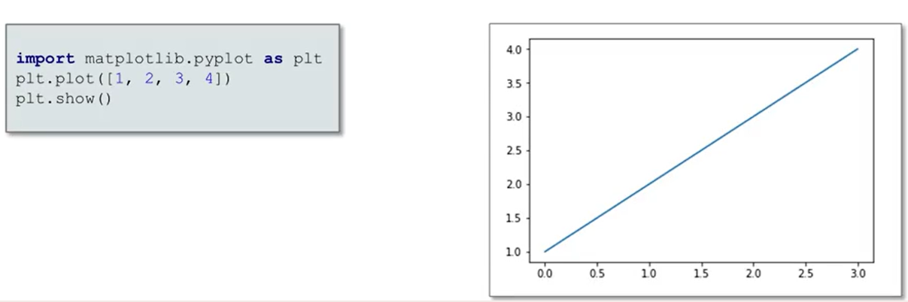
Matplotlib Chart

Slide 6
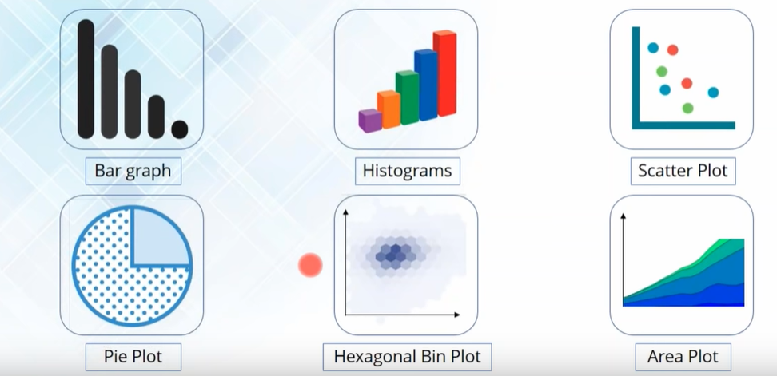
Types of Plots

Slide 7
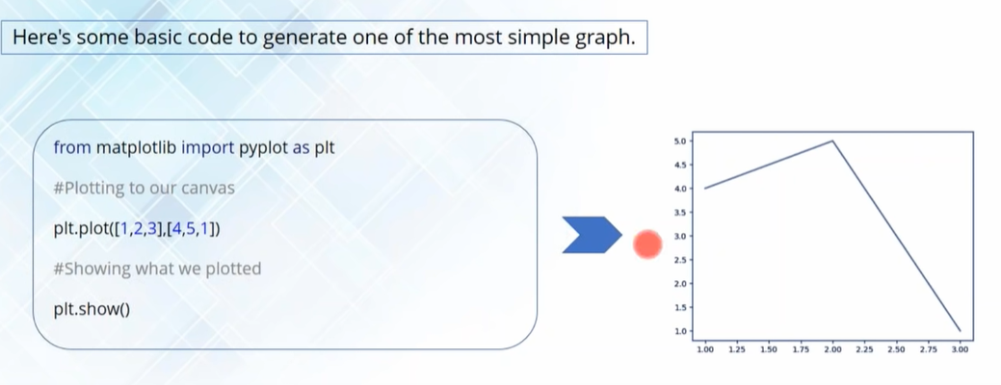

Slide 8
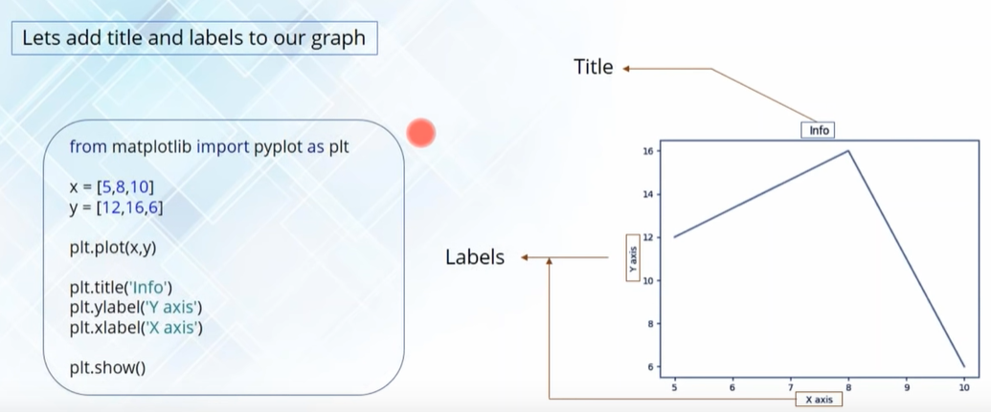

Slide 9
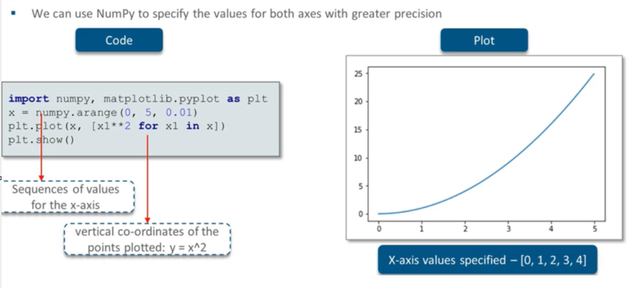
Matplotlib Chart

Slide 10
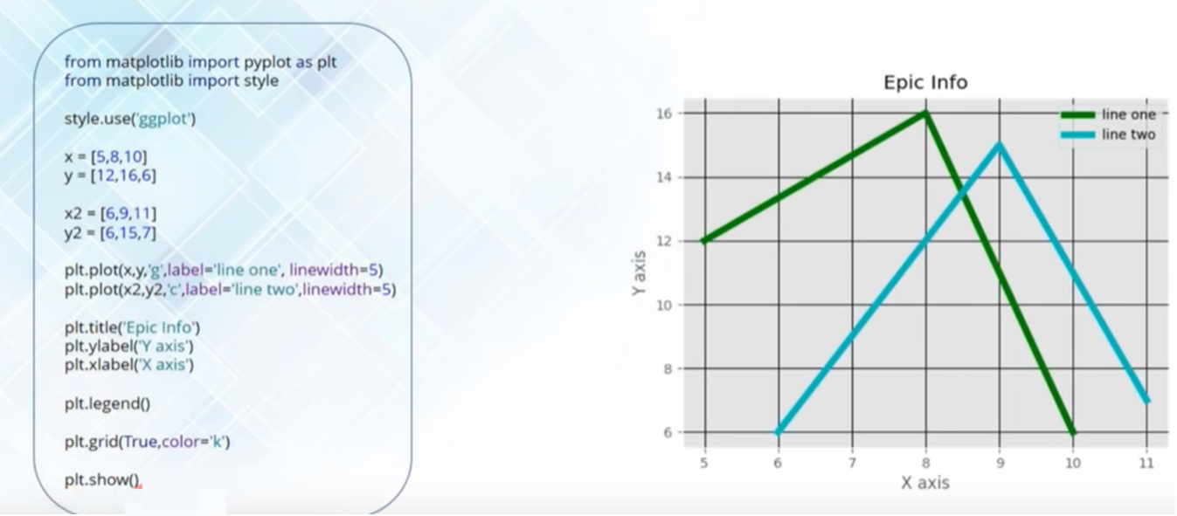
Matplotlib Chart

Slide 11
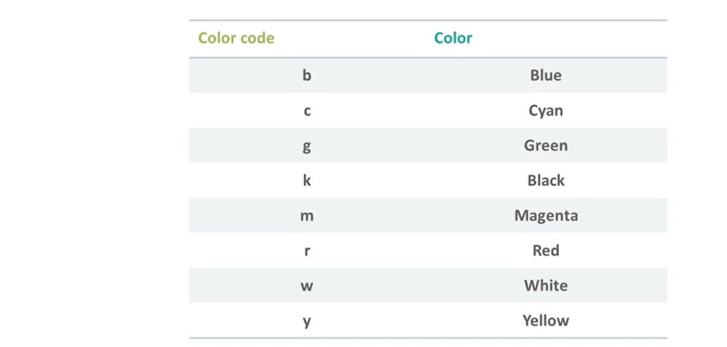
Colour Code
https://matplotlib.org/stable/gallery/color/named_colors.html

Slide 12
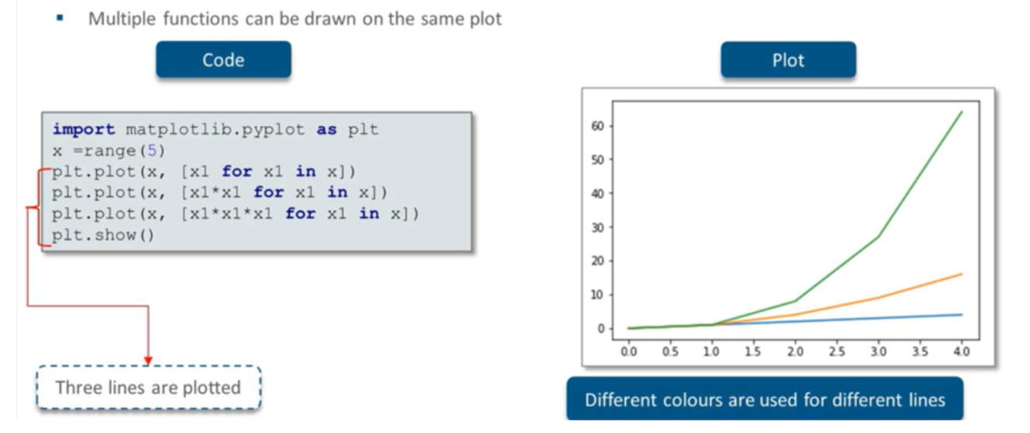
Multiline Plots

Slide 13
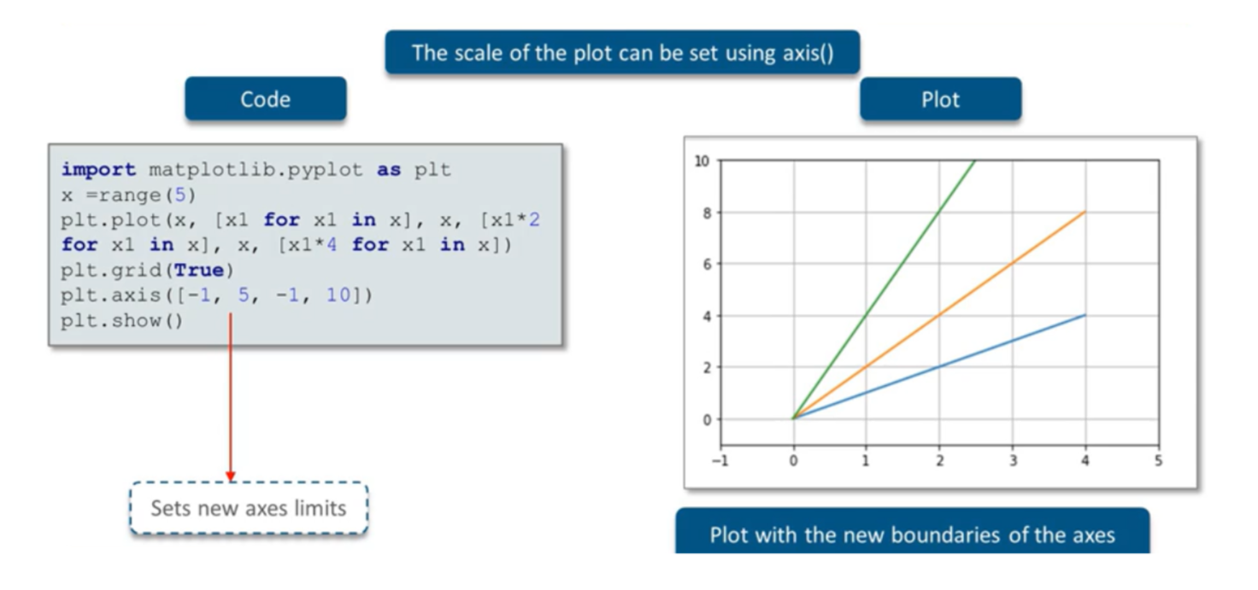
Limiting the Axes

Slide 14
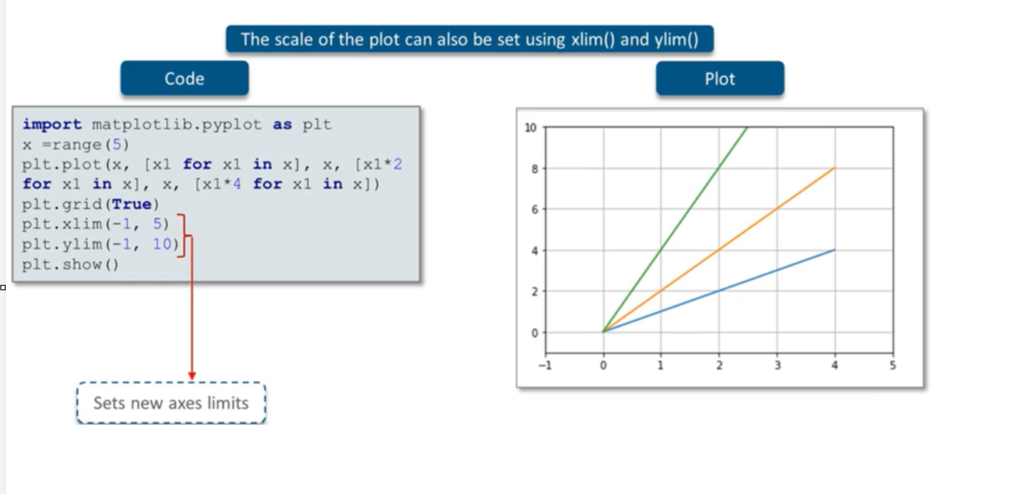
Limiting the Axes

Slide 15
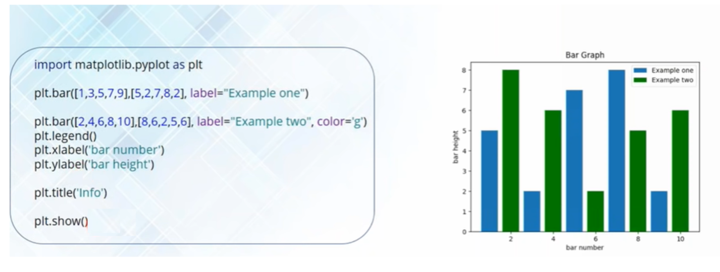
Bar Graph

Slide 16
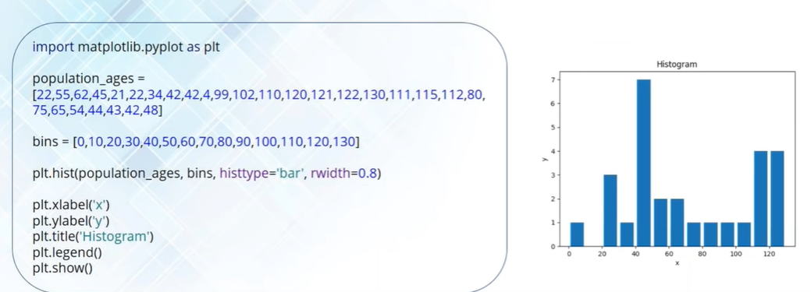
Histogram

Slide 17
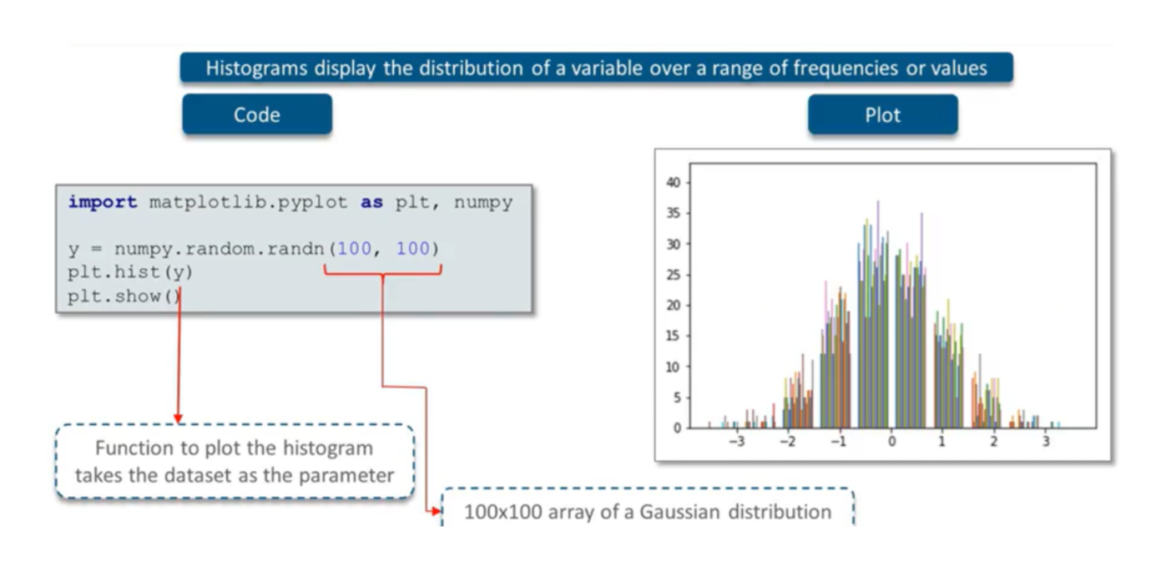
Histogram

Slide 18
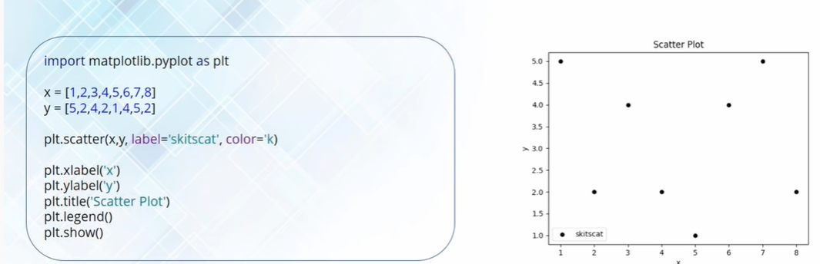
Scatter Plot

Slide 19
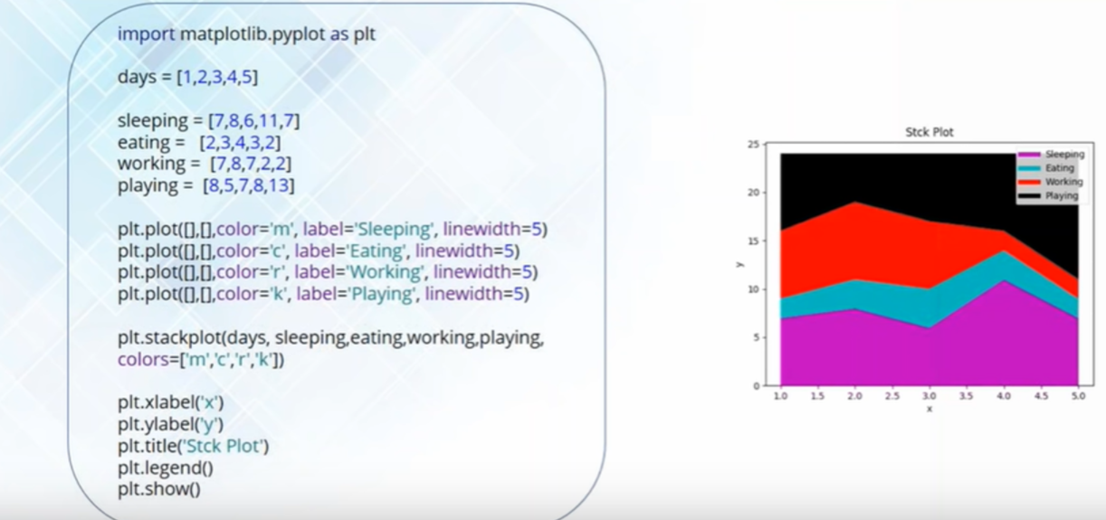
Stack (Area) Graph

Slide 20
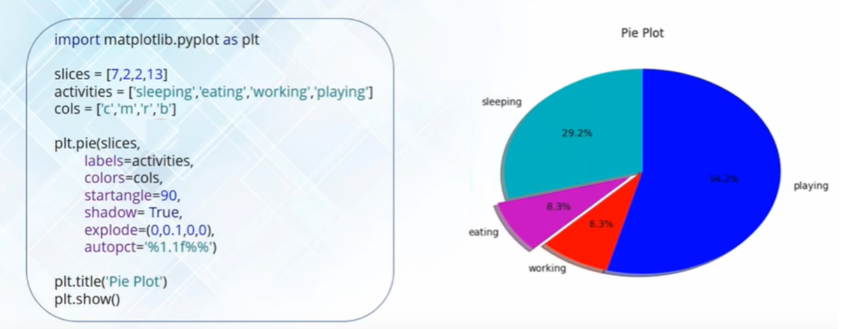
Pie Chart

Slide 21
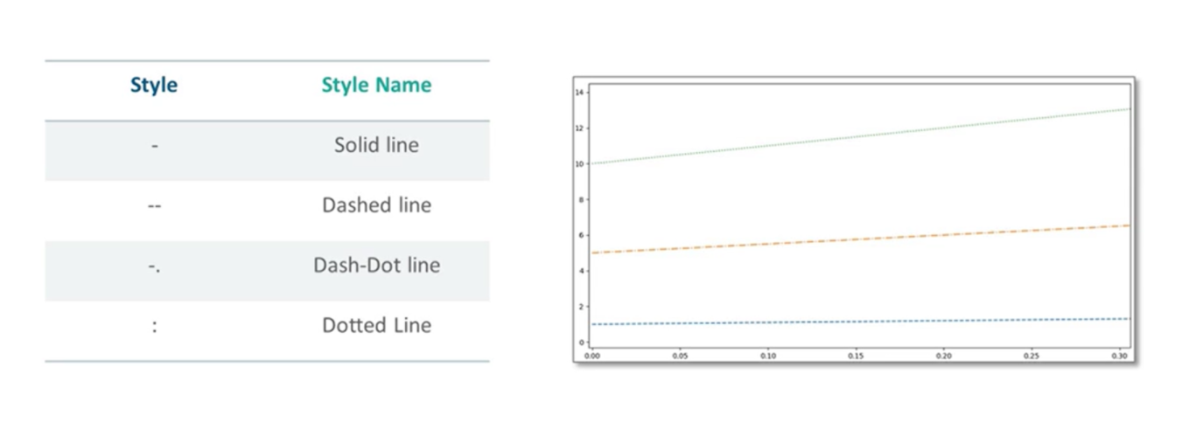
Line Style

Slide 22
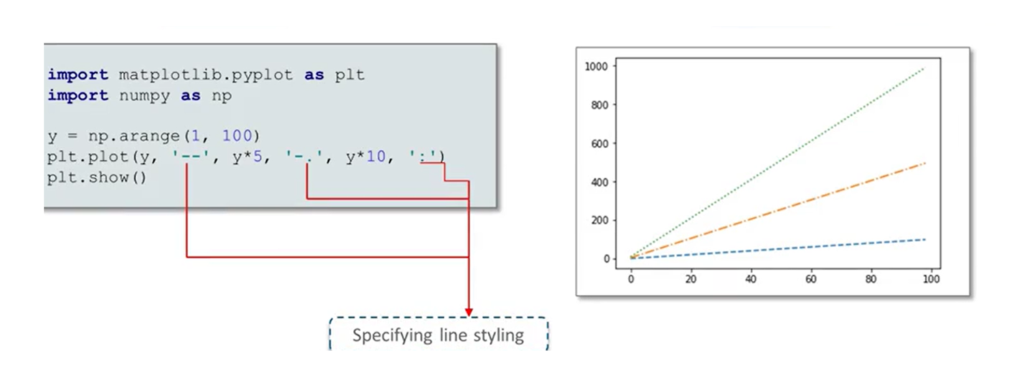
Line Style

Slide 23
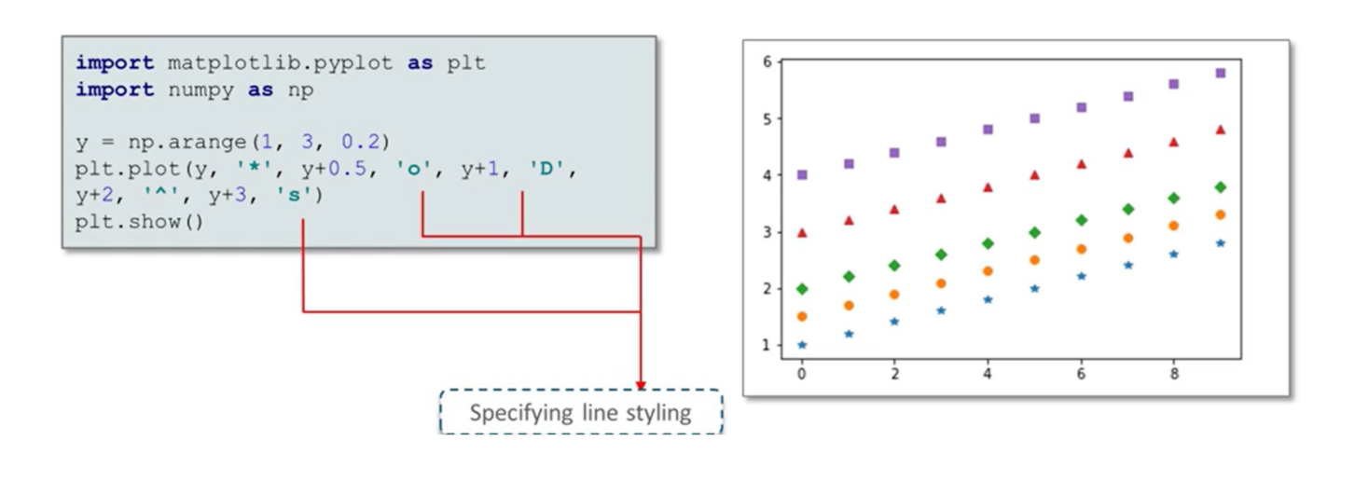
Marker Style

Slide 24
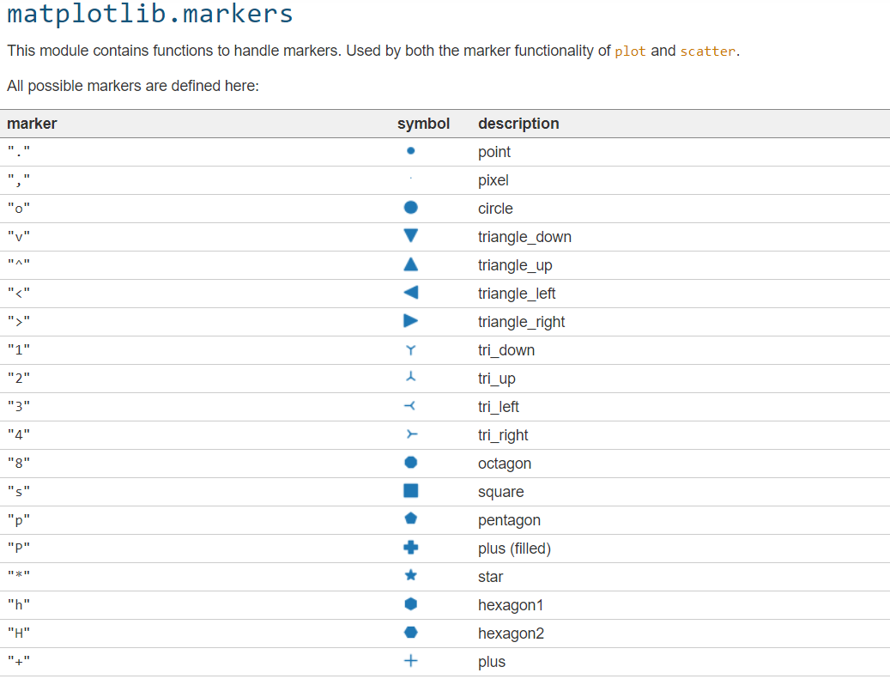
https://matplotlib.org/stable/api/markers_api.html

Slide 25
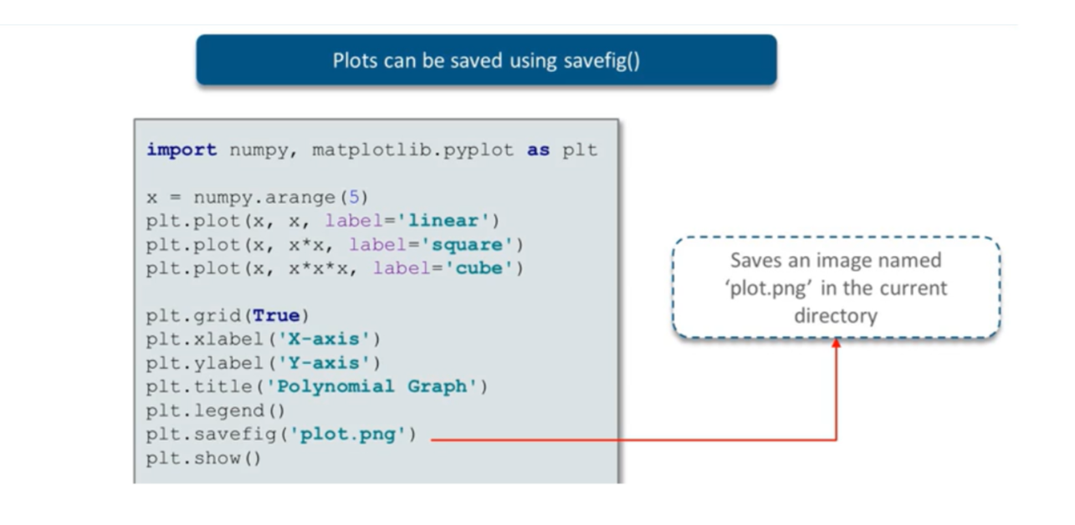
Save Plot

